Slide 1
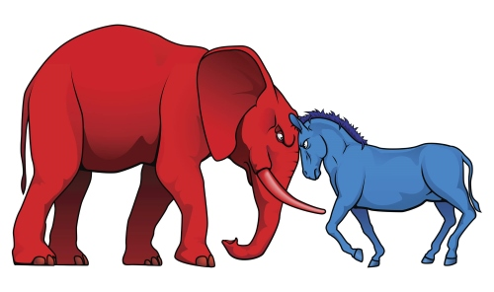
US Political Polarity
AJ Marcus

Slide 2
Politics has become a large societal concern in the United States and the polarizing stances on common issues has given way to social unrest, tension, and distrust.
The goal here is to validate the existence, primary actors, and timeline of political polarity as a baseline for future analysis.
Notes:
My report looks into division in current politics as reflected in Congress and its membership bodies. There is a large history of media and publications on the topic from purple composition of constituent districts to analysis on political extremism. The goal for this report will be to validate some existing points of similar research to create a Congress-to-Citizen proxy analysis baseline for future analysis.

Slide 3
Report Outline
Data Source
Hypothesis
Methodology
Predictions
Data Sources
Primary Source is the Congressional Session and Membership Voting from VoteView.com
Supplemental data compiled from various historical event archives including Library of Congress, White House media relations, and public news feeds.
Notes:
VoteView provides our Congressional and Membership voting history and ideology (by Keith Pool & Howard Rosenthal). It has been in use since 1992 and is considered the de facto source of Congressional actions and votes. Supplemental data is collated from across the web to provide information about Presidential timelines, major US incidents, and global socio-ecominic events.

Slide 4
Report Outline
Data Source
Hypothesis
Methodology
Predictions
Hypothesis
First Phase: The current polarization of political parties exists prominently in Congress; determine occurrence timeline and scale
Second Phase: Current polarization can be identified through each facet of Congressional body, Presidential administration, and neighboring Congressional sessions.
Third Phase: Distill a predictor model to determine Congressional Member voting habits and prescribe Congressional outcomes given current Party compositions.
Notes:
I will be analyzing the data from three facets. The first test is to determine the consistent and growing existence of polarization in Congress with the second test to determine if the polarization is equally represented in each body and strata within Congress. The third phase is to attempt a voting prediction model for the delegates.

Slide 5
Report Outline
Data Source
Hypothesis
Methodology
Predictions
Methodology
Use statistical tests to determine confidence outcomes
No assumption of parametric distributions
Validate segment results against similar analysis
Notes:
I will make no assumptions of the data and not consider any other published methodologies as a baseline for analysis. When possible, results will be tested with multiple methods for inter-model comparison.

Slide 6
Report Outline
Data Source
Hypothesis
Methodology
Predictions
Predictions
US Politics will show polarization beginning in 1970s
Congressional nominate scores will align with Presidential Administration
Member votes will align with Party regardless of Congressional disposition
Voting prediction model will show high efficiency at member level but not at Party level.
Notes:
I expect the presence of polarity to begin in the 1970s as it aligns with findings of other publications and validates my methodology is aligned with others. I have also made assumptions that the overall Party controls its delegates to the point where no individual member of Congress deviates too far from the Party line.

Slide 7

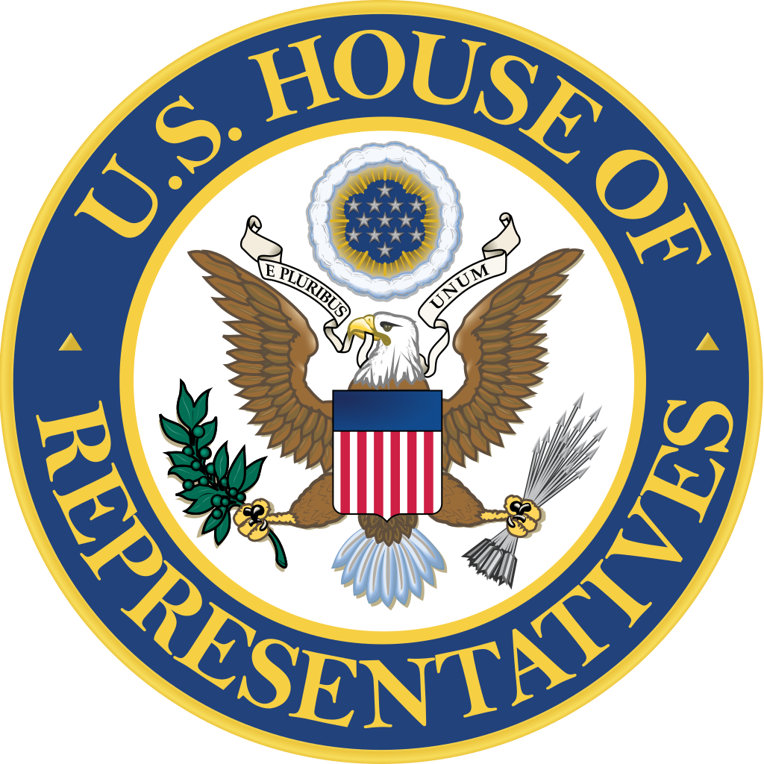
Considerations
Party definitions and dimensions change over time
Nominate scores are based on observed confidence values
Assumes Congress samples the Country’s dispositions
PROS
Data source is established and consistent
Source is population data, not sampling
Peer reports validate the nominate statistic on multiple fronts
CONS
Notes:
This is a proxy analysis of Congress to its Constituents and it makes an assumption the actions of the Government align with the majority of the public. Our data source is strong but only considers a single facet of a larger sociological picture and may result is weak predictive modeling because of its narrow scope. Good descriptive and initial analysis here sets the foundation for a more robust modeling system with the hopes that it can shift to more advanced predictive and prescriptive uses.

